Slide 1
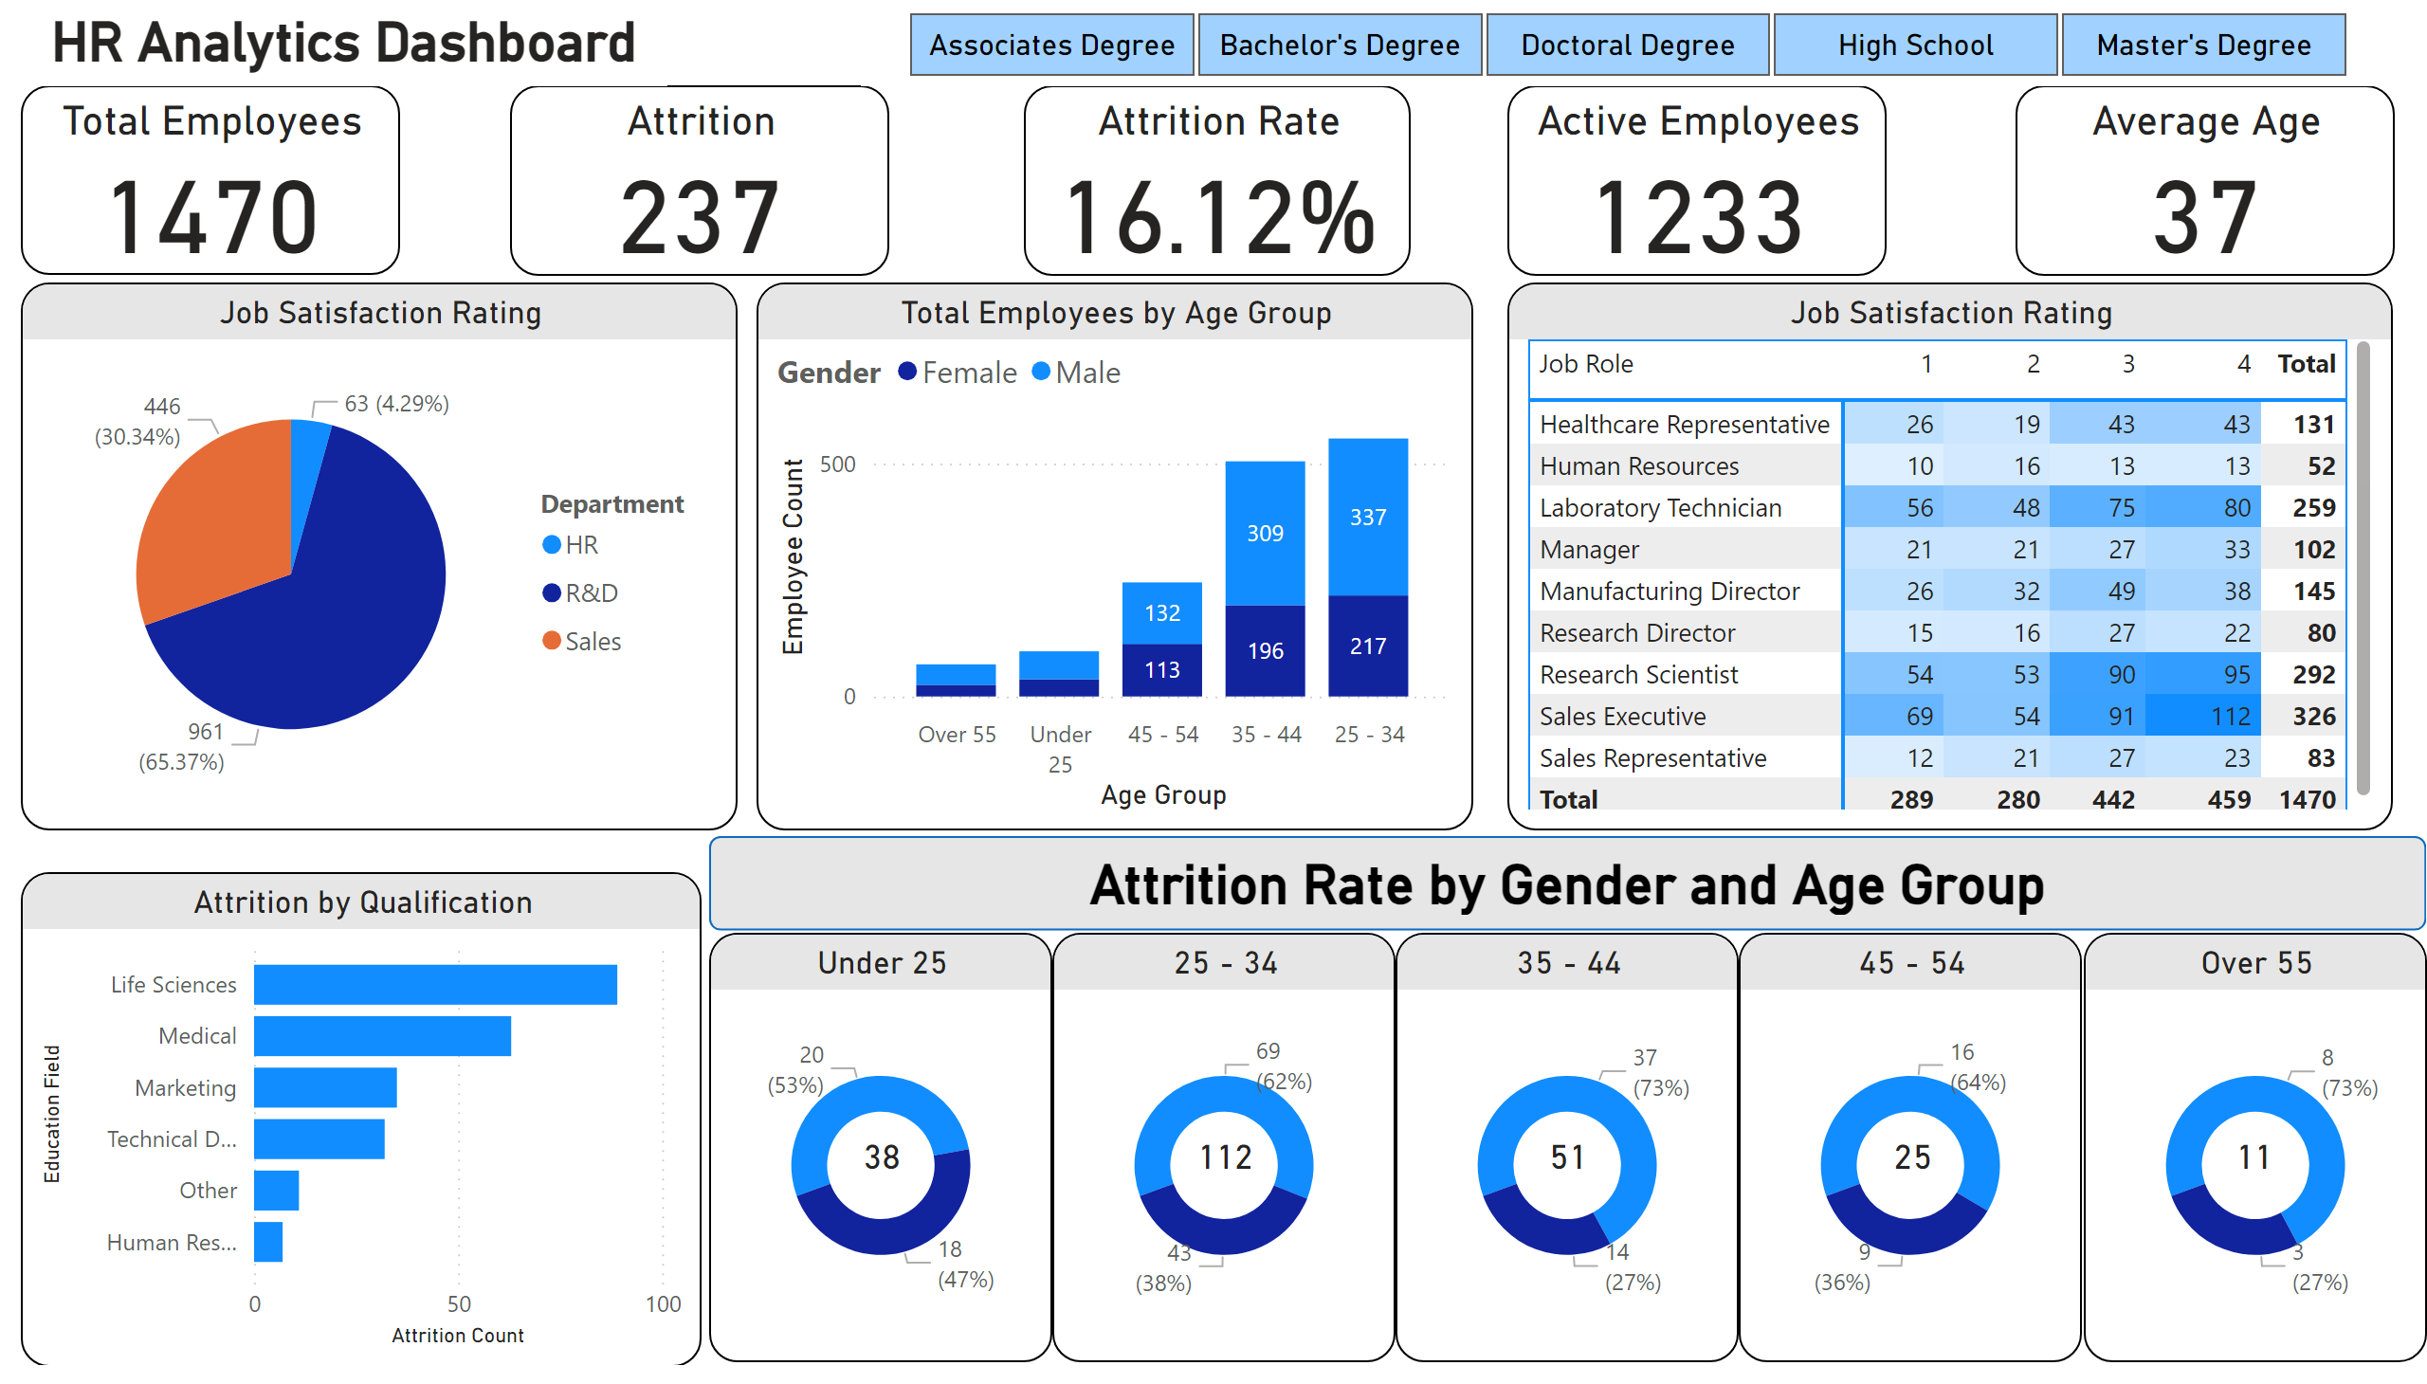
Page 1
Notes:
Total Employees
No alt text provided
Attrition
No alt text provided
Attrition Rate
No alt text provided
Active Employees
No alt text provided
Average Age
No alt text provided
Job Satisfaction Rating
No alt text provided
Total Employees by Age Group
No alt text provided
Job Satisfaction Rating
No alt text provided
Attrition by Qualification
No alt text provided
Under 25
No alt text provided
Over 55
No alt text provided
45 - 54
No alt text provided
35 - 44
No alt text provided
25 - 34
No alt text provided
shape
No alt text provided
card
No alt text provided
card
No alt text provided
card
No alt text provided
card
No alt text provided
card
No alt text provided
textbox
No alt text provided
slicer
No alt text provided

